Slide 1
FATAL ACCIDENTS: Why did they happen?
Erik Dubec, Yang Yang, & ZiAng Zhang
Notes:
Good evening; heavy heart

Slide 2
Introduction
We present a data science study based on 33,000 fatal accidents that occurred in the US in 2015.
The purpose of our study is to find the possible factors that may lead to fatal accidents, including:
Geographical location
Age of the driver
Time (time of the year, day of the week, time of the day)
Weather
We acquired the bulk of our data from Federal Highway Administration’s online database, with supporting data from Google Maps and Open Weather Maps.

Slide 3
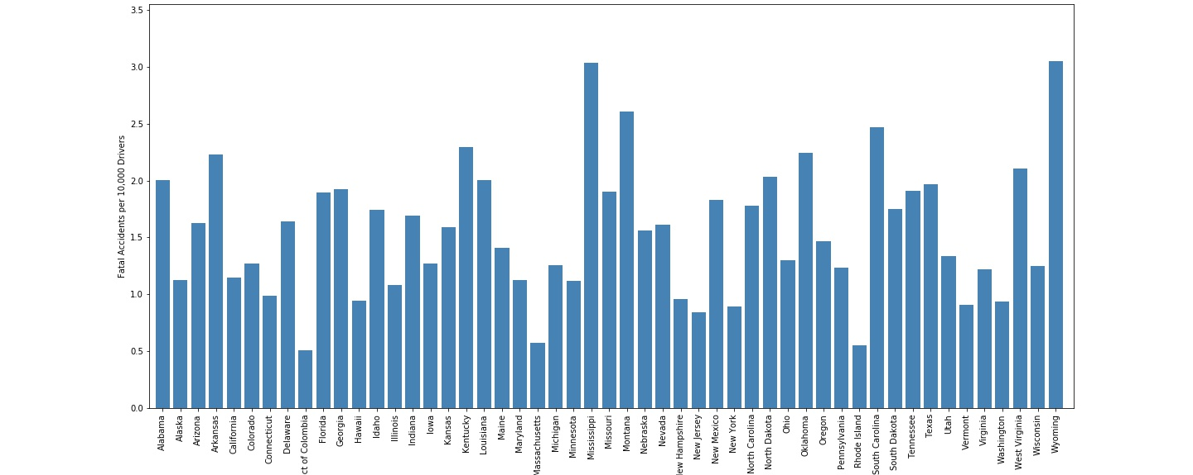
Accidents by state
Notes:
X-axis: state alphabetical; Y-axis; Some indicating trend here; two datasets: main -> fatal accidents; supporting: # registered drivers per state

Slide 4
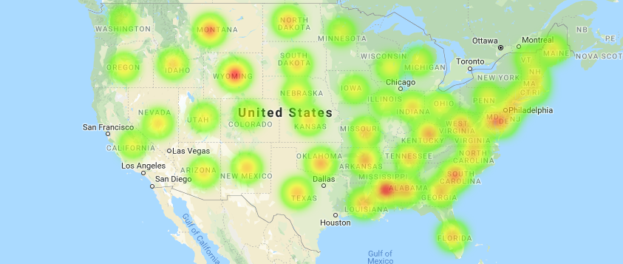
Heatmap
Notes:
Albeit the safer states on the east coast are obscured, we can indeed see the states with the highest amount of accidents

Slide 5
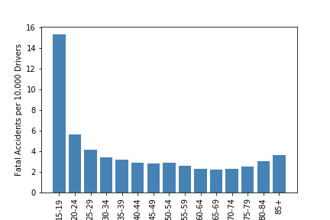
Age
Notes:
Elephant in the room. Teenagers are disproportionally dangerous; safer as you mature; if you have a teenager that insists getting behind the wheel, you know what to do

Slide 6
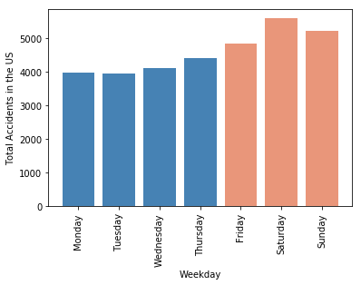
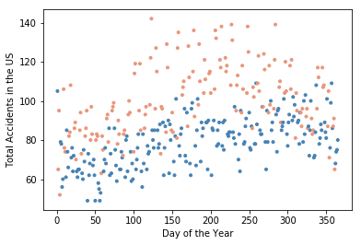
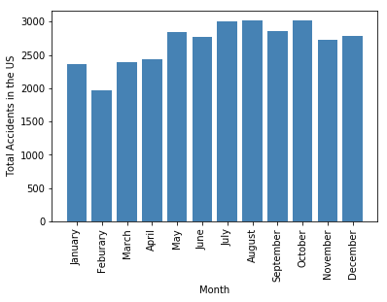
Time of the yearferences
Notes:
Explain a little; Summer and end of the year; You might be wondering about the two colors; Distinctly separated; February new year’s resolution?

Slide 7
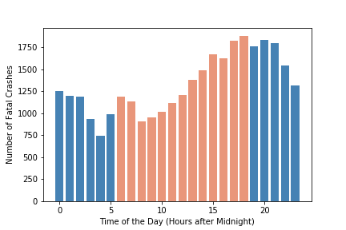
Time of the day
Notes:
If you have no problem with military time, you can read it easily. Lowest around 4am, goes up throughout a day with a minor peak around morning commute; most dangerous at evening commute; if you can work from home, do it; it turns out that not going to work is not only good for your soul

Slide 8
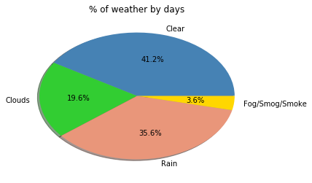
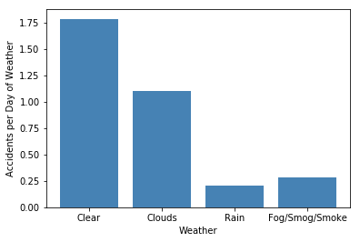
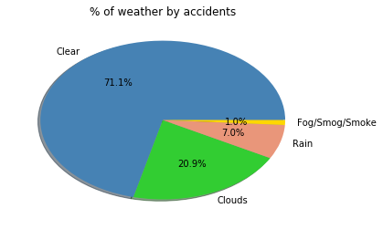
Weather
Notes:
Here comes the black swan – the greatest surprise to us all. Clearer weather are far more dangerous! Two reasons 1) faster cars 2) less attention paid

Slide 9
Comments
By geographical location:
Strong public transportation -> fewer fatal accidents?
Extreme weather -> more fatal accidents?
More data to establish links
By age: teenagers are dangerous
By time
Weekends are more dangerous than weekdays
Summer and end of the year are slightly worse
Evening commute is the worst
By weather: nice weather is more deadly!!
Notes:
Moving on to the more substantial conclusions

Slide 10
References
https://www.fhwa.dot.gov
https://maps.googleapis.com
https://openweathermap.org

